Slide 1
Housekeeping
If you are using Internet Explorer, there are some known issues, and you may not be able to participate in Polls; please copy the URL and paste it into Firefox or Chrome. You can be logged in twice while you change browsers.
If you are having difficulty with audio, check your Audio settings in the GoToTraining control panel. Expand the Audio card and select Computer audio. If you still have difficulties, you can select Phone call and the system will provide you with a telephone number and PIN.
Please use the Chat box for any questions. At the end of the presentation, we will answer as many questions as time permits.
Let's do a quick check to test the functionality of GoToTraining - find the Hand button and put your hand up.
As mentioned earlier, this session has some interactive Polls; so please be sure to pay attention so you can participate.
Speaking of attention, GoToTraining has an Attention feature that lets the presenter know if you’ve clicked away; so if too many are not paying attention, we may create an interaction on the fly.
At the end of this session you will see a pop-up in your browser to complete a brief evaluation. You will also receive a follow-up email about an hour after the training for the same evaluation. You only need to take it once – however, please take a few moments to complete as this allows our team to monitor and improve the quality of our trainings.
Thank you for joining!
Notes:
Good afternoon and thank you for joining us for Human Trafficking and Commercial Sexually Exploitation of Children (CSEC).
I’d like to go over a few Housekeeping items before we get started…

Slide 2

Essentials of Service Delivery

Slide 3
Overview
What is youth’s brain development process?
How can you identify child at-risk?
What are protective factors that can reduce the risk of youth falling victim to human trafficking?
How can you help youth when you believe they are in an unhealthy relationship?
What does normalcy mean?
What is a strength-based approach?
How can you create a transitioning plan and safety plan?
What are your agencies’ responsibilities?

Slide 4
Brain Development in Youth

Slide 5
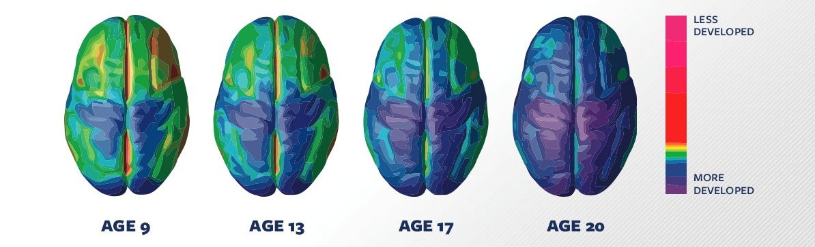
Brain Development in Youth
During the adolescence, the brain is still developing. The prefrontal cortex – which is critical for planning, judgment, decision-making, and impulse control – is one of the last areas to fully develop.
Notes:
Scientists have identified a specific region of the brain called the amygdala that is responsible for immediate reactions including fear and aggressive behavior. This region develops early. However, the frontal cortex, the area of the brain that controls reasoning and helps us think before we act, develops later. This part of the brain is still changing and maturing well into adulthood.
Pictures of the brain in action show that adolescents' brains work differently than adults when they make decisions or solve problems.
Their actions are guided more by the emotional and reactive amygdala and less by the thoughtful, logical frontal cortex.
Research has also shown that exposure to drugs and alcohol during the teen years can change or delay these developments.

Slide 6
Teenage Brain Development
Based on the stage of their brain development, adolescents are more likely to:
Act on impulse
Get involved in fights
Misread or misinterpret social cues and emotions
Engage in dangerous or risky behavior
Get into accidents of all kinds
Notes:
This does not mean that young people can't make good decisions or tell the difference between right and wrong. It also doesn't mean that they shouldn't be held responsible for their actions. However, an awareness of these differences can help us as service providers anticipate and manage the behavior of adolescents.

Slide 7
Teenage Brain Development
Adolescents are less likely to:
Think before they act
Pause to consider the consequences of their actions
Change their dangerous or inappropriate behaviors
Notes:
This does not mean that young people can't make good decisions or tell the difference between right and wrong. It also doesn't mean that they shouldn't be held responsible for their actions. However, an awareness of these differences can help us as service providers anticipate and manage the behavior of adolescents.

Slide 8


Discussion: How Do You See This In The Youth You Serve?
Module 2.1_Adolescent Development

Slide 9
Reasons Youth Run From - Where Youth Run To
Inconsistent or Uncaring Relationships
Placement Rules & Restrictions
“SYSTEM”
Drive for Autonomy & Normalcy
Connections with individuals they believe care about and understand Them!
Connections with Family & Relatives

Slide 10
Case Study: What Happened to Franny
ACM received a phone call from the staff at the Geneses House stating that Franny (FM) runaway. The group home took the children to the library at about 1pm today, and according to the report from Geneses House about 3:45pm when all the children return to the van, Franny was missing. They were loading the van when a staff notice that Franny was not present during head count. A client, Autumn informed the staff that “she stated today was the day.” Franny was wearing a white tank top with blue jeans and Sneakers.
Notes:
This is an actual case so I did not want to alter the information. The reason i chose to share it is becuase it is relatable to things that could take place during any group home off site excursion.

Slide 11


Orlando Sentinel
www. OrlandoSentinel.com
June 11, 2009
Feds: Man Promised To Make Girl A 'Star,' Instead Turned
Her Into A Prostitute
When Dwayne Lawson befriended a 17-year-old Central Florida girl on MySpace, he promised to make her a "star.” Instead, he made her a prostitute -- pimping her out on streets thousands of miles from home, and selling her services on Craigslist, according to a federal criminal complaint.
Now, the 28-year-old Orlando man is behind bars in a California jail, accused of one count of sex trafficking of children. Lawson, also known as "Christopher Young," "Christopher Yoong," and "Staydown," met the girl through her MySpace page in October, the complaint said.
Lawson told the girl, identified in the complaint as "FM," he had a house, cars and money.
FM thought she was going to be a star," the complaint said.
Lawson bought the teen a bus ticket and she traveled to Las Vegas, where she met up with him and an 18-year-old woman who had been working as a prostitute for Lawson for several years. From there, the complaint said, Lawson took the teen and unidentified woman to Orange County, Calif. Lawson told FM the rules -- like don't kiss men on the mouth -- and told her how much to charge.
Lawson and the woman took nude photos of FM, posted them on Craigslist advertising sex in that area, and coached the teen on how to talk to "customers," the complaint said. After FM met with a customer, all of her money went to Lawson.
Eventually, Lawson put FM "on the track" in California and Las Vegas. She was twice arrested on prostitution charges, providing a fake ID to law enforcement on both occasions, and was ticketed and released, the complaint said.
Notes:
OrlandoSentinel.com, Amy L. Edwards, June 11, 2009
When Dwayne Lawson befriended a 17-year-old Central Florida girl on MySpace, he promised to make her a "star.” Instead, he made her a prostitute -- pimping her out on streets thousands of miles from home, and selling her services on Craigslist, according to a federal criminal complaint.
Now, the 28-year-old Orlando man is behind bars in a California jail, accused of one count of sex trafficking of children. Lawson, also known as "Christopher Young," "Christopher Yoong," and "Staydown," met the girl through her MySpace page in October, the complaint said.
Lawson told the girl, identified in the complaint as "FM," he had a house, cars and money.
FM thought she was going to be a star," the complaint said.
Lawson bought the teen a bus ticket and she traveled to Las Vegas, where she met up with him and an 18-year-old woman who had been working as a prostitute for Lawson for several years. From there, the complaint said, Lawson took the teen and unidentified woman to Orange County, Calif. Lawson told FM the rules -- like don't kiss men on the mouth -- and told her how much to charge.
Lawson and the woman took nude photos of FM, posted them on Craigslist advertising sex in that area, and coached the teen on how to talk to "customers," the complaint said. After FM met with a customer, all of her money went to Lawson.
Eventually, Lawson put FM "on the track" in California and Las Vegas. She was twice arrested on prostitution charges, providing a fake ID to law enforcement on both occasions, and was ticketed and released, the complaint said.

Slide 12
At-Risk Children and Protective Factors

Slide 13
Risk Factors
Child or youth at risk of sex trafficking means an individual who has experienced trauma, such as abuse, neglect, and/or maltreatment, and presents with one or more of the accompanying risk factors:
History of running away and/or homelessness
History of sexual abuse and/or sexually acting out behavior
Inappropriate interpersonal and/or social media boundaries
Family history of or exposure to human trafficking
Out-of-home placement instability demonstrated by repeated moves from less restrictive levels of care
Notes:
Protective factors are characteristics associated with a lower likelihood of negative outcomes or that reduce a risk factor's impact. Protective factors may be seen as positive countering events.
Promoting Protective Factors Fact Sheet for Pregnant and Parenting Teens https://www.childwelfare.gov/pubPDFs/guide_teen.pdf

Slide 14
Protective Factors
By fostering protective factors in youth you can reduce the risk of them falling victim to human trafficking:
Education
Family Stability
Strong Social Support Networks
Mental and Emotional Health
Notes:
Protective factors are characteristics associated with a lower likelihood of negative outcomes or that reduce a risk factor's impact. Protective factors may be seen as positive countering events.
Promoting Protective Factors Fact Sheet for Pregnant and Parenting Teens https://www.childwelfare.gov/pubPDFs/guide_teen.pdf

Slide 15

Education
PROTECT

Slide 16
Family Stability
We must remember family is more than the people we are connected to by birth
Talk to youth about who they consider family
Be creative on how you can engage a youth’s family in their development
Notes:
This can be challenging for youth in care – you must be aware of any concerns or court orders that may prohibit contact with certain individuals

Slide 17
Strong Social Support Networks
Help youth to build positive peer relationships
Support from positive friends is related to lower levels of substance use, antisocial behavior, and suicide, as well as academic performance among children exposed to abuse and neglect.
Get youth involved in prosocial activities outside of the home. See how you can partner with your local community organizations to find volunteer opportunities
Notes:
Promoting Protective Factors for Victims of Child Abuse and Neglect: A Guide for Practitioners https://www.childwelfare.gov/pubPDFs/victimscan.pdf
Help youth to build positive peer relationships
Support from positive friends is related to lower levels of substance use, antisocial behavior, and suicide, as well as academic performance among children exposed to abuse and neglect.
Get youth involved in prosocial activities outside of the home. See how you can partner with your local community organizations to find volunteer opportunities.

Slide 18
Mental and Emotional Health
Yoga
Guided Meditation
Equine Therapy
Art Therapy
Creating a Memory Book
Notes:
We know this is important for us all, but we also need to remember it means more than offering our youth individual and group therapy. What else can be considered…

Slide 19
Teen Dating Violence

Slide 20
Teen Dating Violence
Data from CDC's Youth Risk Behavior Survey and the National Intimate Partner and Sexual Violence Survey indicate that:
Nearly 1 in 11 female and approximately 1 in 15 male high school students report having experienced physical dating violence in 2019.
About 1 in 9 female and 1 in 36 male high school students report having experienced sexual dating violence in 2019.
26% of women and 15% of men who were victims of contact sexual violence, physical violence, and/or stalking by an intimate partner in their lifetime first experienced these or other forms of violence by that partner before age 18.
Notes:
https://www.cdc.gov/violenceprevention/intimatepartnerviolence/teendatingviolence/fastfact.html#:~:text=It%20affects%20millions%20of%20teens,violence%20in%20the%20last%20year.
Affects millions of teens in the U.S. each year. Data from CDC's Youth Risk Behavior Survey and the National Intimate Partner and Sexual Violence Survey indicate that:
Nearly 1 in 11 female and approximately 1 in 15 male high school students report having experienced physical dating violence in the last year.
About 1 in 9 female and 1 in 36 male high school students report having experienced sexual dating violence in the last year.
26% of women and 15% of men who were victims of contact sexual violence, physical violence, and/or stalking by an intimate partner in their lifetime first experienced these or other forms of violence by that partner before age 18.

Slide 21
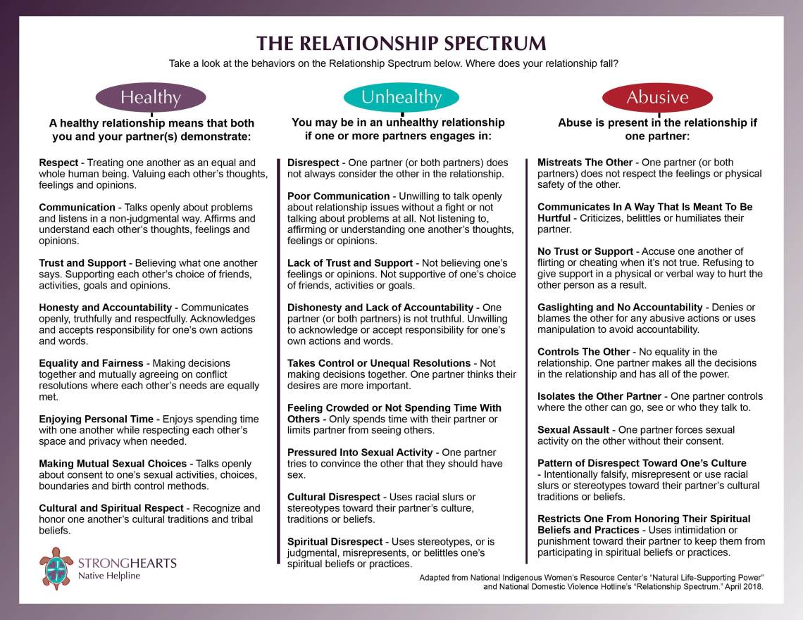
Notes:
Available in participant guide

Slide 22
3 Guidelines for Teen Relationships
Physical Boundaries
Talk to the youth about respecting their personal space and to discuss their boundaries to their girlfriend/boyfriend
Emotional Boundaries
Digital Boundaries
Discuss the when, how, and why the youth should talk about their feelings, how they communicate their need for space, and how they prefer to be treated in words and action
Discuss social media, gaming and other electronics rules. Have open conversations regarding texting, sexting, sending pictures, social media posts, emails, and phone calls
3 Guidelines for Teen Relationships
Notes:
Emotional boundaries discuss the when, how, and why the youth should talk about their feelings, how they communicate their need for space, and how they prefer to be treated in words and action. Everyone deserves to be loved and treated in a respectful way. Remember the saying: Treat others how you want to be treated…
Physical boundaries talk to the youth about respecting their personal space and to discuss their boundaries to their girlfriend/boyfriend. How to they feel about touching or holding hands and continue to talk about thing that make them comfortable or uncomfortable as the relationship progresses.
Digital boundaries discuss social media, gaming and other electronics rules. Explain why rules are needed. Have open conversations regarding texting, sexting, sending pictures, social media posts, emails, and phone calls. In the digital age, setting digital boundaries is critical, and can lay the foundation for creating healthy boundaries in real life – or IRL as your youth would probably say ☺

Slide 23
Healthy Relationship
In a healthy/respectful relationship, your significant other:
  Tells the truth
  Compromises
  Gives you space to be yourself
  Admits when they’re wrong
Talks through conflict in a productive manner
Honors your boundaries, emotions, and point of view
Values your family and friends
Listens when you say “No”
Accepts it when you change your mind – especially if/when you want to break up

Slide 24
Unhealthy Relationship
  Humiliates you OR belittles your opinion
Calls you names – i.e. insults – during arguments or when angry
  Tries to get serious too quickly-pressure you into doing things you are not ready
Makes you afraid to express your thoughts or feelings
  Breaks things to intimidate you
Threatens to break up all the time
  Threatens to hurt themselves if you break up with them
Fails to respect your emotional, physical, and digital boundaries
Asks you to choose between them and family/friends
Pressures you into using drugs, drinking, or other risky/illegal behavior
Pressures you into sexual behavior by saying “If you love me, you’ll…”
Hurts you physically
Demands you be on call for them 24/7 no matter what
Says they can’t live without you
Makes you afraid of how they’ll react to bad news
Checks up on you, texts or calls incessantly

Slide 25
Recognizing Early Signs
The boyfriend/girlfriend:
Pressures the youth to make the relationship serious or to have sex early in the relationship
Is extremely jealous and possessive
Exhibits controlling behaviors and will not allow the youth to make their own decisions
Refuses to see the youth’s point of view or desires
Notes:
The youth is pressured to make the relationship serious or to have sex early in the relationship
The boyfriend/girlfriend is extremely jealousy and possessive. They may tell the youth that they are this way because they love or falling in love with them.
Exhibits controlling behaviors and will not allow the youth to make their own decisions.
Refuses to see the youth’s point of view or desires.
Keeping the youth from spending time with friends or participating in positive extracurricular activities.

Slide 26
Recognizing Early Signs
The boyfriend/girlfriend:
Keeps the youth from spending time with friends or participating in positive extracurricular activities
Is verbally abusive which may include yelling, cussing, manipulation, spreading rumors and/or making the youth feel guilty
Encourages the youth to drink alcohol and/or using drugs
Threatens the youth to use physical violence
Notes:
The boyfriend/girlfriend
Keeps the youth from spending time with friends or participating in positive extracurricular activities
Is verbally abuse which may include yelling, cussing, manipulation, spreading rumors and/or making the youth feel guilty
Encourages the youth to drink alcohol and/or using drugs
Threatens the youth to use physical violence

Slide 27
Helping Youth Who Is In A Violent Relationship
Make a safety plan with the youth
Encourage the youth to talk with someone they trust, such as a teacher, guidance counselor, case manager, or mentor
Contact the youth’s case manger and counselor or call the police if they report a crime
Understand that the violence will not just stop or go away and will most likely become more violent over time
Discuss with the youth that it is not their role to change their boyfriend/girlfriend
Explain and stress that they are not responsible for the abuse
Notes:
Make a safety plan with the youth
Encourage the youth to talk with someone they trust: such as a teacher, guidance counselor, case manger or mentor…
Contact the youth’s case manger and counselor or call the police if they report a crime.
Understand that the violence will not just stop or go away and will most likely become more violent over time.
Discuss with the youth that it is not their role to change their boyfriend/girlfriend.
Explain and stress that they are not responsible for the abuse.

Slide 28
Normalcy

Slide 29
Normalcy in Daily Life
The quality or condition of being normal!
August 2005 memo from former DCF Secretary Hadi
  “Administration, staff & CBC providers should encourage foster parents & group home staff to make decisions regarding foster children’s participation in normal activities.”
Notes:
Ask staff to share what some of the policies their agency has in place that support “Normalcy”
How do you engage youth in this conversation?

Slide 30
Normalcy
What does this mean & how can your program facilitate normalcy with respect to issues such as:
    Dating?
    Clothes?
    Food?
    Curfew?
    Music?
    Internet Access?
    Phone Privileges?
    Access to Friends?
    Extra Curricular School Activities?
Notes:
Ask staff to share what some of the policies their agency has in place that support “Normalcy”
How do you engage youth in this conversation? \
Youth are valued partners who should have meaningful, decision-making roles in programs and the community they live in.

Slide 31
LGBTQ Normalcy Principles
Exploring sexual orientation, gender identity, and gender expression is a normal part of human identity development
Young people who identify as LGBTQ or gender non-conforming are as “normal” as their heterosexual and cisgender peers
Providing normalcy for LGBTQ children and youth requires creating safe spaces for them and providing services that directly address sexuality, gender-based needs, and the “coming out process”
Supporting LGBTQ children and youth in accessing the highest quality opportunities to meet their needs
Notes:
Exploring sexual orientation, gender identity, and gender expression is a normal part of human identity development.
Young people who identify as LGBTQ or gender non-conforming are as “normal” as their heterosexual and cisgender peers.
Providing normalcy for LGBTQ children and youth requires creating safe spaces for them and providing services that directly address sexuality, gender-based needs, and the “coming out process.”
It is best practice for child welfare agencies to support LGBTQ children and youth in accessing the highest quality opportunities to meet their needs.

Slide 32

Creating Normalcy for LGBTQ Children and Youth
Research shows that adults who respond to LGBTQ children and youth with accepting behaviors promote a greater sense of well-being as compared to those that respond with rejecting behaviors. Child welfare systems promote accepting behaviors by:
Training staff to be comfortable discussing sexual orientation, gender identity, and gender expression (SOGIE)
Including SOGIE in nondiscrimination policies8 8 Ibid
Creating emotionally and physically safe spaces for LGBTQ children and youth
Displaying symbols that represent the LGBTQ community
Training staff to be familiar with sexuality and gender terminology and concepts
Encouraging LGBTQ youth to participate in decision-making bodies that can inform improvement efforts
Developing policies that address normalcy considerations for LGBTQ children and youth
Notes:
https://library.childwelfare.gov/cwig/ws/library/docs/gateway/Blob/105738.pdf?w=+NATIVE%28%27recno%3D105738%27%29&upp=0&rpp=10&r=1&m=1
Research shows that adults who respond to LGBTQ children and youth with accepting behaviors promote a greater sense of well-being as compared to those that respond with rejecting behaviors. Child welfare systems promote accepting behaviors by:
Training staff to be comfortable discussing sexual orientation, gender identity, and gender expression (SOGIE)
Creating emotionally and physically safe spaces for LGBTQ children and youth
Training staff to be familiar with sexuality and gender terminology and concepts
Developing policies that address normalcy considerations for LGBTQ children and youth
Encouraging LGBTQ youth to participate in decision-making bodies that can inform improvement efforts
Including SOGIE in nondiscrimination policies8 8 Ibid.
Displaying symbols that represent the LGBTQ community

Slide 33
Strength-based Approach When Working with At-risk Youth

Slide 34
Strength-based Approach
Focuses on the positive attributes, of a person or a group, rather than the negative ones
Allows youth to see themselves at their best, in order to see the value they bring, by just being themselves.
Helps youth to identifies anything that may be holding them back in their individual growth

Slide 35
3 Core Needs of Children
Feeling Safe
Healthy Connections
Adaptive Coping
Notes:
Feeling Safe: Children who have experienced trauma are continually alert to the possibility of threat. They experience chronic stress and anxiety that impacts on their emotions and behavior. We can support children and young people by creating an environment of emotional and culturally safety where their emotions and perceptions are acknowledged and respected.
Healthy Connections: Children and young people in care can be acutely aware that they are different and can hunger for normality. Mixing with local kids and your community helps normalize their experience and develop healthy connections with caregivers. We can support healthy relationships by focusing on their connections with kids, rather than focusing on teaching them how to behave.
Adaptive Coping: Children and young people in care who have experienced trauma can have difficulty controlling their emotions and impulses. Research tells us that learning to manage emotions is based on the availability of support, coaching and trust from caregivers – so your role is vital. Active listening and focusing on the feelings that are driving their behavior will assist these kids develop healthy and adaptive strategies to cope with the past.
Supporting children who've experienced trauma - Fostering a child | Family & Community Services (nsw.gov.au)

Slide 36
3 Core Needs of Children
Feeling Safe
Healthy Connections
Adaptive Coping
Children who have experienced trauma are continually alert to the possibility of threat. They experience chronic stress and anxiety that impacts on their emotions and behavior. We can support children and young people by creating an environment of emotional and culturally safety where their emotions and perceptions are acknowledged and respected.
Notes:
Feeling Safe: Children who have experienced trauma are continually alert to the possibility of threat. They experience chronic stress and anxiety that impacts on their emotions and behavior. We can support children and young people by creating an environment of emotional and culturally safety where their emotions and perceptions are acknowledged and respected.
Healthy Connections: Children and young people in care can be acutely aware that they are different and can hunger for normality. Mixing with local kids and your community helps normalize their experience and develop healthy connections with caregivers. We can support healthy relationships by focusing on their connections with kids, rather than focusing on teaching them how to behave.
Adaptive Coping: Children and young people in care who have experienced trauma can have difficulty controlling their emotions and impulses. Research tells us that learning to manage emotions is based on the availability of support, coaching and trust from caregivers – so your role is vital. Active listening and focusing on the feelings that are driving their behavior will assist these kids develop healthy and adaptive strategies to cope with the past.
Supporting children who've experienced trauma - Fostering a child | Family & Community Services (nsw.gov.au)

Slide 37
3 Core Needs of Children
Feeling Safe
Healthy Connections
Adaptive Coping
Children and young people in care can be acutely aware that they are different and can hunger for normality. Mixing with local kids and your community helps normalize their experience and develop healthy connections with caregivers. We can support healthy relationships by focusing on their connections with kids, rather than focusing on teaching them how to behave.
Notes:
Feeling Safe: Children who have experienced trauma are continually alert to the possibility of threat. They experience chronic stress and anxiety that impacts on their emotions and behavior. We can support children and young people by creating an environment of emotional and culturally safety where their emotions and perceptions are acknowledged and respected.
Healthy Connections: Children and young people in care can be acutely aware that they are different and can hunger for normality. Mixing with local kids and your community helps normalize their experience and develop healthy connections with caregivers. We can support healthy relationships by focusing on their connections with kids, rather than focusing on teaching them how to behave.
Adaptive Coping: Children and young people in care who have experienced trauma can have difficulty controlling their emotions and impulses. Research tells us that learning to manage emotions is based on the availability of support, coaching and trust from caregivers – so your role is vital. Active listening and focusing on the feelings that are driving their behavior will assist these kids develop healthy and adaptive strategies to cope with the past.
Supporting children who've experienced trauma - Fostering a child | Family & Community Services (nsw.gov.au)

Slide 38
3 Core Needs of Children
Feeling Safe
Healthy Connections
Adaptive Coping
Children and young people in care who have experienced trauma can have difficulty controlling their emotions and impulses. Research tells us that learning to manage emotions is based on the availability of support, coaching and trust from caregivers – so your role is vital. Active listening and focusing on the feelings that are driving their behavior will assist these kids develop healthy and adaptive strategies to cope with the past.
Notes:
Feeling Safe: Children who have experienced trauma are continually alert to the possibility of threat. They experience chronic stress and anxiety that impacts on their emotions and behavior. We can support children and young people by creating an environment of emotional and culturally safety where their emotions and perceptions are acknowledged and respected.
Healthy Connections: Children and young people in care can be acutely aware that they are different and can hunger for normality. Mixing with local kids and your community helps normalize their experience and develop healthy connections with caregivers. We can support healthy relationships by focusing on their connections with kids, rather than focusing on teaching them how to behave.
Adaptive Coping: Children and young people in care who have experienced trauma can have difficulty controlling their emotions and impulses. Research tells us that learning to manage emotions is based on the availability of support, coaching and trust from caregivers – so your role is vital. Active listening and focusing on the feelings that are driving their behavior will assist these kids develop healthy and adaptive strategies to cope with the past.
Supporting children who've experienced trauma - Fostering a child | Family & Community Services (nsw.gov.au)

Slide 39

Helping Children Cope
Supporting Children Who’ve Experienced Trauma
Dr. Howard Bath
Notes:
Play video at 5:35-14:49
How do children cope….
How can we help children develop healthy coping strategies
https://youtu.be/Gng-dclTbqU
Open youtube file to play video or use hidden slide to play in powerpoint .

Slide 40

Supporting Children Who’ve Experienced Trauma
Dr. Howard Bath
Notes:
Play video at 5:41-14:49
How do children cope….
How can we help children develop healthy coping strategies
https://youtu.be/Gng-dclTbqU
You can play the video in powerpoint, however, to prevent freezing, you can open the video in the browser in youtube.

Slide 41
How to Use Strength-based Approach
Learn how to set goals and expectations
Learn how to cope in a productive method that can foster growth
Learn that when faced with a challenge it is better to confront than avoid
Awareness of vulnerabilities and weaknesses but focus on strengths
Builds self-esteem and competence
Learn effective interpersonal skills in order to look for assistance and support when needed
Understand what can and cannot be controlled
Understand supporting others and giving time to those that we care about
Encourage connecting to a person’s social support like family, or community to spur on his or her own transformation
Notes:
Learn how to set goals and expectations.
Learn how to cope in a productive method that can foster growth.
Learn that when faced with a challenge it is better to confront than avoid.
Awareness of vulnerabilities and weaknesses but focus on strengths.
Builds self-esteem and competence.
Learn effective interpersonal skills in order to look for assistance and support when needed.
Understand what can and cannot be controlled.
Understand supporting others and giving time to those that we care about.
Encourages connecting to a person’s social support like family, or community to spur on his or her own transformation.

Slide 42
Benefits of Using Strength-based Approach
Offers youth a new mindset and different perspective
Improves resiliency of youth as well as the overall function of youth in their family and community
Offers a shared language
Respects that in order to build someone up, including their capacities, it takes time and there is a process of evolvement
Sees people as creating and rebuilding, rather than broken or failing
Introduces and molds a person into being resilient
Notes:
https://positivepsychology.com/strengths-based-interventions/
Hammond, 2010
Focusing on strengths rather than problems offers control to the person and a new mindset.
Resilience is improved as well as the overall function of the person in their family and community.
Offers a shared language
Respects that in order to build someone up, including their capacities, it takes time and there is a process of evolvement.
Sees people as creating and rebuilding, rather than broken or failing.
Focusing on strengths of a person also introduces and molds a person into being resilient. With resilience there are some added benefits, like feeling special and valued, optimistic, understand life is a journey.

Slide 43
Safety Planning

Slide 44
Types Of Safety
Physical Safety
  Tangible, concrete, easily observed or defined
    i.e. – wearing a helmet, certificates of inspection, etc
Emotional Safety
  Intangible, not concrete or easily observed, may be difficult to define – more descriptive
    i.e. – bodily reactions (heartbeat, breathing)

Slide 45
Providing Physical Safety
What are some tangible needs for safety?
  Housing
  Food
  Clothing
  What else?
Notes:
Alarm systems; lighting at night; cameras in open spaces and/or outside; access to telephone or communication

Slide 46
Providing Emotional Safety
What are some intangible needs for safety?
  Acceptance
  Healthy relationships
  A sense of empowerment
  What else?
Notes:
Freedom from abuse; positive peer groups; respect; leadership opportunities

Slide 47
What can we do?
Provide sensory comfort, familiarity,
Empathize, connect, try to understand the person’s view.
Provide structure, control, inclusion, predictability.
Provide Psycho-education on common trauma responses
Product of “Reducing the Trauma of Investigation, Removal and Initial Out of Home Placement Project”, 2008.
Notes:
For initial removal and placement….
Ask the children about their favorite foods, their bedtime routines, hobbies, favorite things to do.
Have a welcome basket for a new child when they arrive.
Provide physical soothing (rocking, food).
Cook favorite foods (sensory stimulation)
Show them around the house, their room, where the kitchen and snacks are.
Do they take any medications?
Be open to listening if they want to talk (don’t probe or grill them), Acknowledge their feelings.
Assure them they are safe and will be cared for.
Honor their relationship with their parents, support contact with parents, grandparents and siblings.
Provide parents with information about how their kids are doing.
Children benefit and feel reassured when they see all the adults working together to resolve issues and to make a good plan and make things better. Working in partnership with the bio-families…how to resolve any conflicts (feelings of anger, feelings of resentment regarding the abusive situations that kids are in), how do you do that successfully?---ask for feedback. Examples, of how to do so (licensing, PI, CM, therapists, etc).

Slide 48
Activity: Creating Safety Plans
Scenario #1: Youth comes to you and tells you that one of their friends got a message on Instagram about a modeling opportunity. The youth tells you her friend was invited to meet up with the modeling agent and that she was invited to go with her.
Scenario #2: Youth in your home often goes on elopement for several days at a time. On Friday morning she tells staff she will not be coming back after school but will be back on Sunday night.
Scenario #3: Come up with your own scenario
Notes:
Activity is written is we can break the participants out into virtual groups-if not an option the activity will be altered
Think through the situation, where might you be at risk of emotional or physical harm.
Prepare a plan for how you would stay safe in the scenario that you created. What are three practical steps that can be taken to prepare for this situation? Identify who should be part of the safety plan?
What are two resources that can help you during this situation? Who will you share your safety plan with?

Slide 49
Necessity of Safety Planning for HT Victims
Safety plan helps youth get perspective and support when they are in crisis and may not be able to make appropriate decisions for themselves.
By encouraging youth to write down their safety plan, they’ll be better equipped to keep themselves safe.
When a youth shares their safety plan, they know that if they are in a dangerous situation, they can ALWAYS get help.
Notes:
A safety plan helps youth get perspective and support when they are in crisis and may not be able to make appropriate decisions for themselves.
By encouraging youth to write down their safety plan, they’ll be better equipped to keep themselves safe.
When a youth shares their safety plan, they know that if they are in a dangerous situation, they can ALWAYS get help

Slide 50
Activity: Creating Safety Plans
1
2
3
STEP
STEP
STEP
Present your safety plan
What do you think about this process?
What was difficult about creating these plans?
Notes:
Activity is written is we can break the participants out into virtual groups-if not an option the activity will be altered
Think through the situation, where might you be at risk of emotional or physical harm.
Prepare a plan for how you would stay safe in the scenario that you created. What are three practical steps that can be taken to prepare for this situation? Identify who should be part of the safety plan?
What are two resources that can help you during this situation? Who will you share your safety plan with?

Slide 51
Transition Planning

Slide 52
Transition Planning
Transition Support Team
Case Manager
GAL/
ALL
Current Placement Provider
Caregiver
Adult Supports Youth Identified
Therapist
Family Youth Identified
Life Coach Mentor
Notes:
Efforts should be made to enhance and develop existing relationships with adults whom youth trust, or with whom trust could be strengthened.
Building the capacity of existing relationships to offer more empathetic and insightful emotional support could provide important resources for the youth as he or she leaves out-of-home placement and continues to deal with the emotions and questions raised by his or her experiences prior to, and during, placement.”
**Remember you are not responsible to lead the Transition Plan, but you are an important part of the team**

Slide 53
Transition Planning
Ensure youth is involved in transition planning
Ask youth how she or he would like to participate in their transition plan
Include current relevant service providers to discuss ongoing service delivery
Ensure import documents and all personal belongs are transitioned with the youth
Notes:
Transition planning for all youth in foster care is critical for their emotional and behavioral wellbeing. Youth may be transiting from one placement to another, they may be reunified or adopted or aging out of the foster care system. During this process we need to remember:
Youth must be at the table when the transition plan is developed.
Youth should be asked who they would like to participate in their transition plan.
Current relevant service providers should be included so that ongoing service delivery can be discussed.
Ensure import documents and all personal belongs are transitioned with the youth

Slide 54


Independent Living – Transition Planning
Youth -focused
Always keep in mind that young adults can be provided with the experience of living independently while still in a supportive environment
Bring the team together
Be creative
Be the youth’s advocate
Notes:
Advocate for what you believe is best for the youth but always factor in the youth’s voice
Youth Focus – Planning should be center around the youth and involving the youth, be considerate of their time and availability
Be Creative - Before you eliminate options discuss them and follow up to see if something that may not have been tried before can be done
Bring the Team Together – You are part of this team, be available to participate in this process as the information you have as the youth's caregiver can help to ensure a smooth transition.
Be Creative – Don’t get caught up in what the plan looked like for the last youth in your program, focus on what would be best for this youth. Be creative, consider the youths interests and how you can tie that into their Transition Plan.
Be the youth’s advocate – Advocate for the youth during this process. Any transition can be scary and often can cause anxiety. Be sure to advocate for the youth during this process, help to ensure their voice is heard. When necessary report your concerns to the appropriate CBC staff and or the youth attorney ad lietm.

Slide 55
Independent Living – Transition Planning
Always consider the followings:
Type & Location of Housing
Continuity of Services
Frequency of Visitation/Contact
Notes:
Type & Location of Housing – Become familiar with the housing option for youth transitioning to Extended Foster Care (EFC) or Post-secondary Educational Support Services (PESS) in youth area. The CBC/CMO Independent Living Staff would be your best point of contact for this information.
Continuity of Services – Determine early on if services the youth is currently receiving can continue after they turn 18. If not bring this up to the Transition Team so you can assist with ensuring a transfer of services from one provider to an other.
Frequency of Visitation/Contact – Youth participating in EFC will still have visitation with a case manager, if you feel a youth may need more frequent contact upon transition based on what you have experienced during their time in your program, be sure to share that with the Transition Team.

Slide 56
Independent Living – Transition Planning
Continuity of Services
Education Support
Job Coaching
Health Care
Legal Support
Counseling
Housing
Notes:
Remember that as the youth caretaker during this time you play a significant role in the process preparing them for independence.

Slide 57
Your Agency’s Responsibilities

Slide 58
Cultural Competency
Cultural Competency: the ability of individuals and systems to respond respectfully and effectively to people of all cultures, classes, races, ethnic backgrounds, sexual orientations, and faiths or religions in a manner that recognizes, affirms, and values the worth of individuals, families, tribes, and communities, and protects and preserves the dignity of each.
An individual and professional’s ability to treat every person with dignity, respect, and fairness
It implies that organizations set in place a set of practices, policies, and behaviors that are congruent with principles of equity, fairness, and inclusion of cultural differences and a commitment to address social inequities among cultural groups
Notes:
The Child Welfare League of America defines cultural competency as the ability of individuals and systems to respond respectfully and effectively to people of all cultures, classes, races, ethnic backgrounds, sexual orientations, and faiths or religions in a manner that recognizes, affirms, and values the worth of individuals, families, tribes, and communities, and protects and preserves the dignity of each" (Child Welfare League of America, 2001, Cultural Competence Defined).
In practice this involves an individual and professional’s ability to treat every person with dignity, respect, and fairness.
It implies that organizations set in place a set of practices, policies, and behaviors that are congruent with principles of equity, fairness, and inclusion of cultural differences and a commitment to address social inequities among cultural groups.
We need to be aware of culture differences and how they may effect some of the decisions the youth you serve will make.
Ask participants to provide examples:
In some country's youth begin to work at a very early age to help support the family
In some country’s young girls are encouraged to marry significantly older men

Slide 59
Training Requirements
The child-caring agency MUST ENSURE:
All staff meet the training requirements as noted in 65C- 46 Standards for At-Risk Houses.
There are available staff trained in a department approved human trafficking prevention education curriculum to facilitate to youth residing in the home.
Training should be geared to educating children and youth, who are at risk of human trafficking, with strategies to remain safe from exploitation.
Notes:
65C-46.019 Standards for At-Risk Houses.

Slide 60
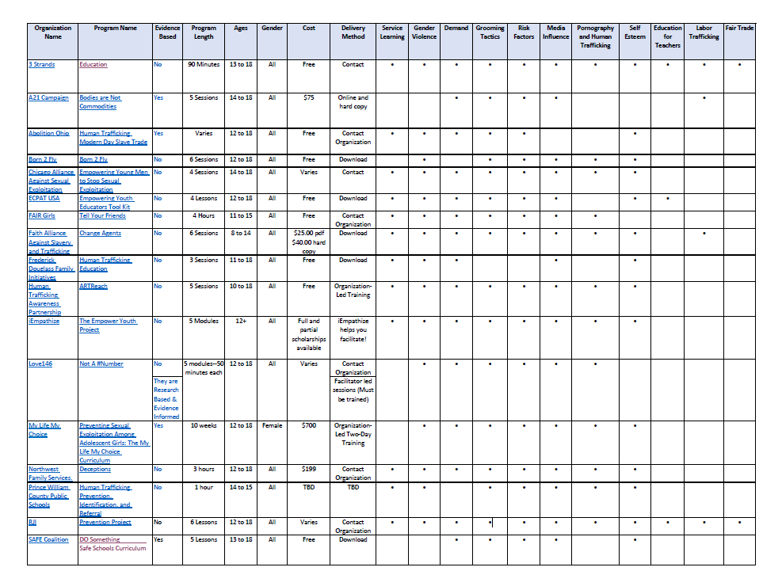
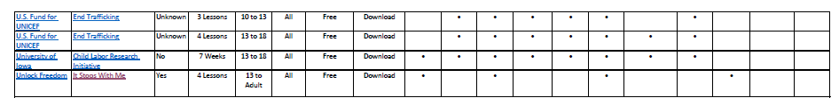
P r e v e n t
I o n
https://nesteducators.org

Slide 61
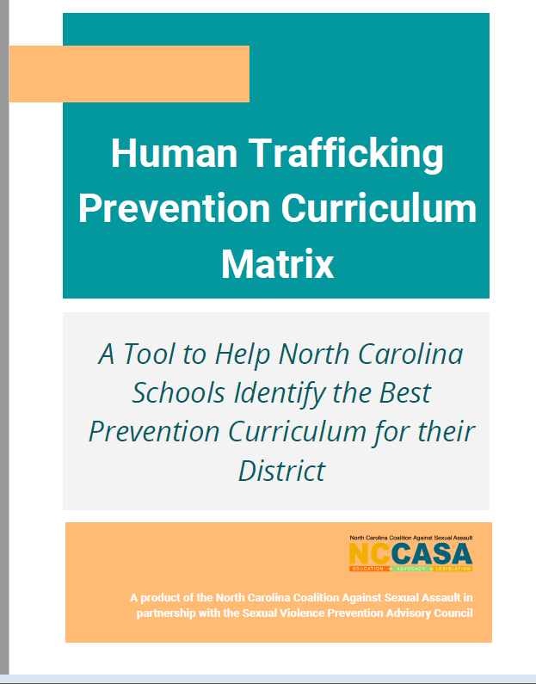
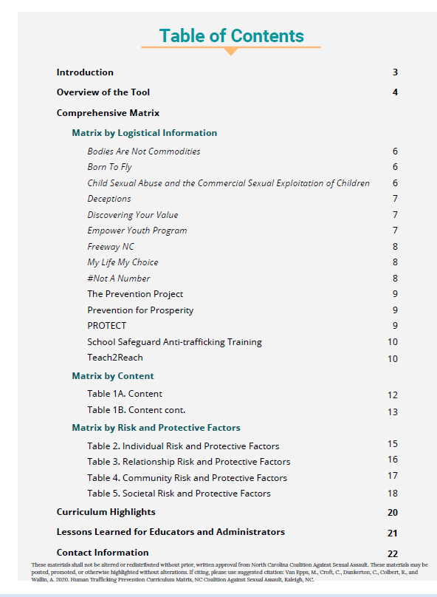
NCCASA HT Prevention Curriculum
Notes:
http://cm20-s3-nccasa.s3.us-west-2.amazonaws.com/ResourceFiles/70a91068e90741af9c6760c05974f352NCCASA_Human_Trafficking_Prevention_Curriculum.pdf

Slide 62
Important and Critical Reminders
When working with youth who may be at risk for human trafficking, to best serve this population,
Develop additional techniques (to those used with other clients) to build rapport with them
Create youth-centered solutions, such as daily care and treatment approaches
Empower them
Provide safety and involve a multidisciplinary approach
Always focus on strengths and positive outcomes
Use your words wisely
Notes:
Staff need to recognize that when working with youth who may be at risk for human trafficking, they need to develop additional techniques (to those used with other clients) to build rapport with them and to reduce the mistrust that they commonly have about people.
To best serve this population, daily care and treatment approaches need to remain centered on the youth, empower them, provide safety and involve a multidisciplinary approach.
Always focus on strengths and positive outcomes
The words we choose MATTER

Slide 63
For your questions:
Sue Aboul-hosn
Department of Children and Families
Regional Human Trafficking Coordinator
Central and Suncoast Regions
Sue.Aboul-hosn@myflfamilies.com
Marina Anderson
Department of Children and Families
Regional Human Trafficking Coordinator
Northeast and Northwest Regions
Marina.Anderson@myflfamilies.com

